Slide 1
Nurturing Young Mathematicians
Pakistan 2024
Charlie Gilderdale
NRICH Mathematics Project
University of Cambridge

Slide 2
Think about a personal goal or ambition
that you succeeded in achieving …
How did you achieve it?

Slide 3
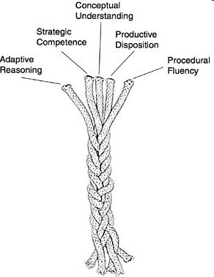
NRICH tasks aim to strengthen these
five strands of mathematical proficiency
Nurturing Successful Mathematicians
https://nrich.maths.org/ropemodel
Kilpatrick et al
NRC (2001)
Adding it up:
Helping children learn mathematics

Slide 4
Conceptual understanding -
comprehension of mathematical concepts, operations, and relations
Procedural fluency -
skill in carrying out procedures flexibly, accurately, efficiently, and appropriately
Strategic competence -
ability to formulate, represent, and solve mathematical problems
Adaptive reasoning -
capacity for logical thought, reflection, explanation, and justification
Productive disposition -
habitual inclination to see mathematics as sensible, useful, and worthwhile, coupled with a belief in diligence and one’s own efficacy.

Slide 5
nrich.maths.org/pakistan2024

Slide 6
… some take-away messages…

Slide 7
The most exciting phrase to hear in science, the one that heralds new discoveries, is not Eureka!, but rather,
“hmmm… that’s funny…”
Isaac Asimov
Engaging learners
mathematics

Slide 8
Mathematics is not a spectator sport
Exploring
→ Noticing Patterns
→ Conjecturing
→ Generalising
→ Explaining
→ Justifying
→ Proving
Notes:
Low Threshold, High Ceiling tasks:Offer students genuine choice Give all students the chance to work mathematically
Creativity in English – reading others’ work and writing work of your own. Creativity in maths – as well as being exposed to important mathematical results, creating mathematics of your own. LTHC – everyone has the right to get stuck and make mistakes in a safe environment, everyone has an entitlement to work mathematically.

Slide 9
What can we offer students?
Low Threshold, High Ceiling tasks
A conjecturing culture where it is OK to make mistakes
Opportunities to exhibit and refine their understanding
Opportunities to discuss mathematical ideas
A careful use of guiding questions and prompts
Opportunities to practice skills in an engaging way: HOTS not MOTS
Teachers who model and value mathematical behaviours

Slide 10
What Teachers Can Do
  Aim to do for learners only what they cannot yet do for themselves
  Focus on provoking learners to
    use and develop their (mathematical) powers
    make mathematically significant choices

Slide 11
I don't expect, and I don't want, all children to find mathematics an engrossing study, or one that they want to devote themselves to either in school or in their lives. Only a few will find mathematics seductive enough to sustain a long-term engagement.
But I would hope that all children could experience at a few moments in their careers ... the power and excitement of mathematics ... so that at the end of their formal education they at least know what it is like, and whether it is an activity that has a place in their future.
David Wheeler

Slide 12
… a teacher of mathematics has a great opportunity.
If he fills his allotted time with drilling his students in routine operations he kills their interest, hampers their intellectual development, and misuses his opportunity.
But if he challenges the curiosity of his students by setting them problems proportionate to their knowledge, and helps them to solve their problems with stimulating questions, he may give them a taste for, and some means of, independent thinking.“
Polya, G. (1945) How to Solve it

Slide 13
When you return to school…
What...
With whom…
When…
How…
Why…
will you share what we’ve discussed today?
https://nrich.maths.org/pakistan2024

Slide 14
Reflecting on today: the next steps
Think big, start small
Think far, start near to home
Two weeks with the students or it’s lost……

Slide 15
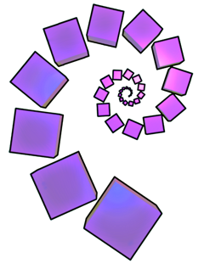
Thank you
Charlie Gilderdale
secondary.nrich@maths.org

